Slide 1
DDR SUBSYSTEM

Slide 2
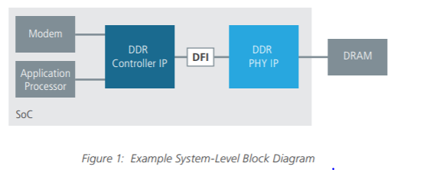
DDR SUBSYSTEM

Slide 4
A DRAM memory-access protocol defines
commands and timing constraints that a DRAM
memory controller uses to manage the movement
of data between itself and DRAM devices

Slide 5
Basic DRAM Commands
Row Access Command
The row access command is also known as the row activation command. The purpose of a row access command is to move data from the cells in the DRAM arrays to the sense amplifiers and then restore the data back into the cells in the DRAM arrays as part of the same command.
Two timing parameters are associated with a row access command: tRCD and tRAS.
tRCD :- The time it takes for the row access command to move data from the DRAM cell arrays to the sense amplifi ers is known as the Row Column (Command) Delay.
tRAS:-The time it takes for a row access command to discharge and restore data from the row of DRAM cells is known as the Row Access Strobe latency.

Slide 6
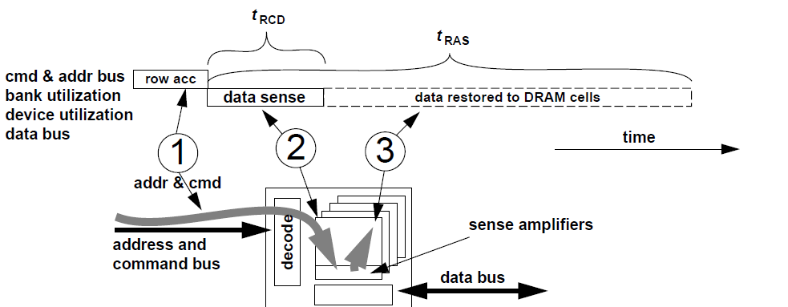

Slide 7
Column-Read Command:-
A column-read command moves data from the array of sense amplifiers of a given bank of DRAM arrays through the data bus back to the memory controller.
Three basic timing parameters are associated with a column-read command: tCAS, tCCD, and tBURST.
tCAS:- The Column Access Strobe Latency (tCAS, or tCL) is the time it takes for the DRAM device to place the requested data onto the data bus after issuance of the column-read command.
tCCD :-The internal burst length of the DRAM device.The timing parameter tCCD represents the timing of minimum burst duration, or minimum column-to-column command timing.
tBURST:- The duration of the data burst on the data bus for a single column-read.

Slide 8
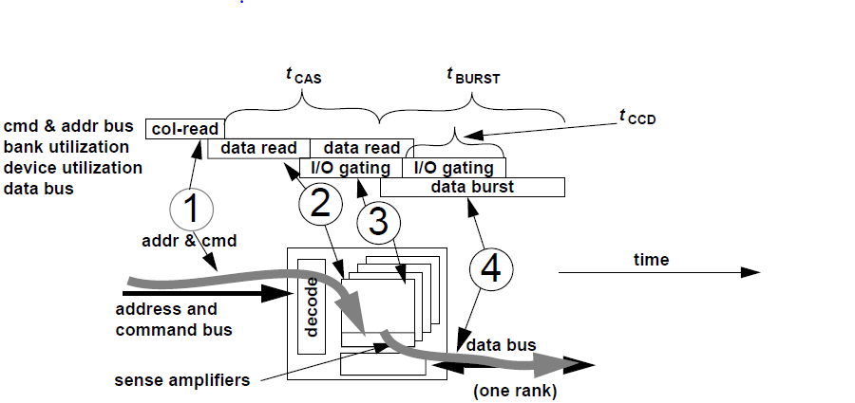

Slide 9
Column-Write Command
A column-write command moves data from the memory controller to the sense- amplifiers of the targeted bank.
The column-write command goes through a similar set of overlapped phases as
the column-read command, but the direction of data movement differs between a column-read command and a column-write command.
tCWD(column write delay):-The column-write delay specifies the timing between assertion of the column-write command on the command bus and the placement of the write data
onto the data bus by the memory controller.

Slide 10
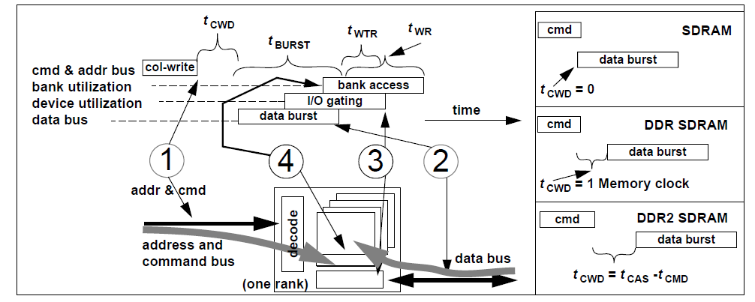
Column-Write Command
A column-write command moves data from the memory controller to the sense amplifiers of the targeted bank.
tCWD(column write delay):- The column-write delay specifies the timing between assertion of the column-write command on the command bus and the placement of the write data onto the data bus by the memory controller.

Slide 11
Pre charge Command
The recharge command completes the row access sequence as it resets the sense amplifiers and the bitlines and prepares them for another row access command to the same array of DRAM cells.

Slide 12
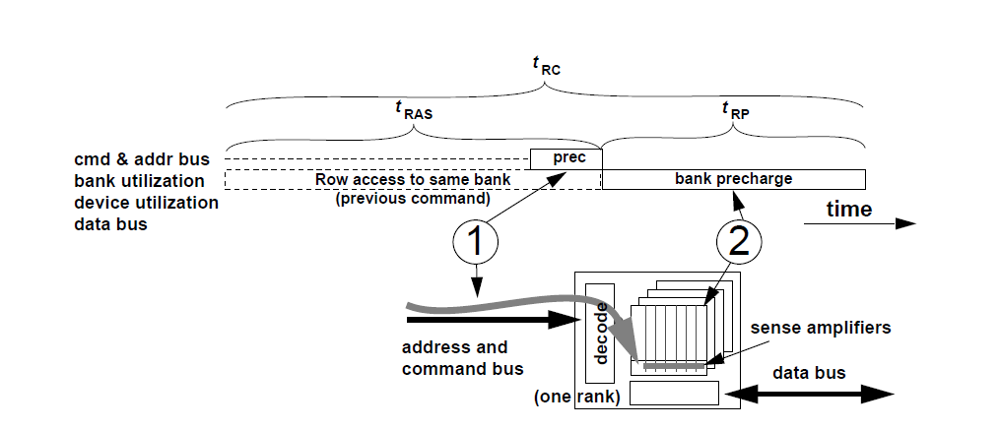

Slide 13
tRP:- time after the assertion of the precharge command the bitlines and sense amplifiers of the selected bank are properly precharged, and a subsequent row access command can be sent to the just precharged bank of DRAM cells.

Slide 14
Refresh Command
The word “DRAM” is an acronym for Dynamic Random Access Memory.
The nature of the non- persistent charge storage in the DRAM cells means that the electrical charge stored in the storage capacitors will gradually leak out through the access transistors. Consequently to maintain data integrity, data value stored in DRAM cells must be periodically read out and restored to their respective, full voltage level before the stored electrical charges decay to indistinguishable levels. The refresh command accomplishes the task of data read-out and restoration in DRAM devices, and as long as the time interval between refresh commands made to a given row of a DRAM array is shorter than the worst-case data decay time, DRAM refresh commands can be used to ensure data integrity.

Slide 15
The refresh command accomplishes the task of data read-out and restoration in DRAM devices, and as long as the time interval between refresh commands made to given row of a DRAM array is shorter than the worst-case data decay time, DRAM refresh commands can be used to ensure data integrity.
The drawback to the refresh mechanism is that the refresh action consumes available bandwidth and power. Consequently, different refresh mechanisms are used in different systems; some are designed to minimize controller complexity, and some are designed to minimize bandwidth impact, while still others are designed to minimize power consumption.

Slide 16
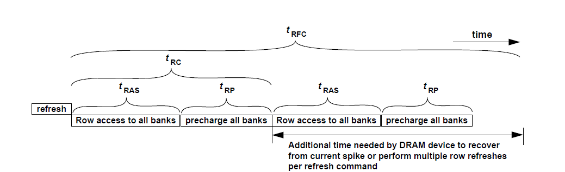

Slide 17
A Read Cycle
In a typical, modern DRAM device each row access command brings thousands of bits of data to the array of sense amplifiers in a given bank.
A subsequent column-read command then brings tens or hundreds of those bits of data through the data bus into the memory controller. For applications that access data by streaming through memory, keeping thousands of bits of a given row of data active at the sense amplifiers ensures that subsequent memory reads from the same row do not incur the latency or energy cost of another row access.

Slide 18
In contrast, applications that are not likely to access data in adjacent locations favor memory systems that immediately precharge the DRAM arrays after each row access to prepare the DRAM bank for a subsequent access to a different row within the same bank.
After tRCD time, data from the requested row is resolved by the sense amplifiers, and the memory controller can then issue column read or write commands to the DRAM device

Slide 19
close-page memory systems.
Memory systems that immediately precharge a bank to prepare it for another access to a different row are known as close-page memory systems.

Slide 20
open-page memory
Memory systems that keep rows active at the sense amplifiers are known as open-page memory systems.

Slide 21
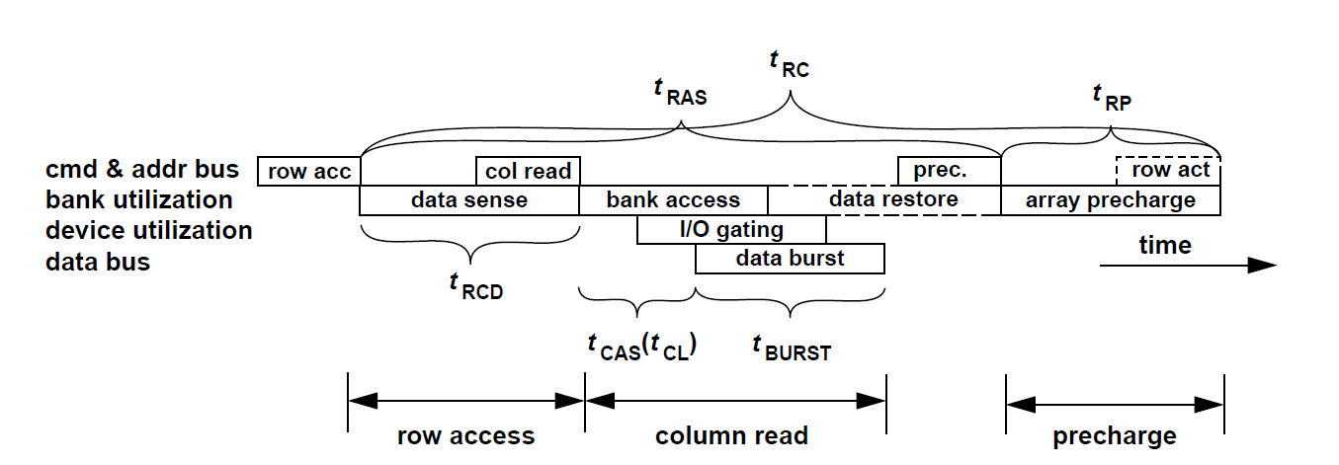

Slide 22
A Write Cycle
In modern DRAM devices, the row cycle time is limited by the duration of the write cycle That is, a row cycle time is defined as The minimum time period that a DRAM device needs to provide access to any data to any row in a given bank of DRAM cells.
the access in the definition of a row access can be a read access or a write access.
In the case of a write access, data must be provided by the memory controller, driven through the data bus, passed through the I/O gating multiplexors, overdrive the sense amplifiers, and finally stored into the DRAM cells.
This complex series of actions must be completed before the precharge command that completes the sequence can proceed.

Slide 23
The rowcycle time must be defi ned so that it can account for the row access time, the column write delay, the data transport time, the write data restore time, as well as the precharge time.
That is, to account for the timing of the more complex write access time, tRAS must be long enough to account for tRCD, tCWD, tCCD, 3 and tWR.As a result, the timing parameter tRAS must be set so that it is at least equal to tRCD tCWD tCCD tWR in SDRAM, DDR SDRAM, and DDR2 SDRAM devices,subject to the clock cycle granularity of the respective latency values, thus demonstrating the write cycle time constraint of the row cycle time in these commodity DRAM devices.

Slide 24
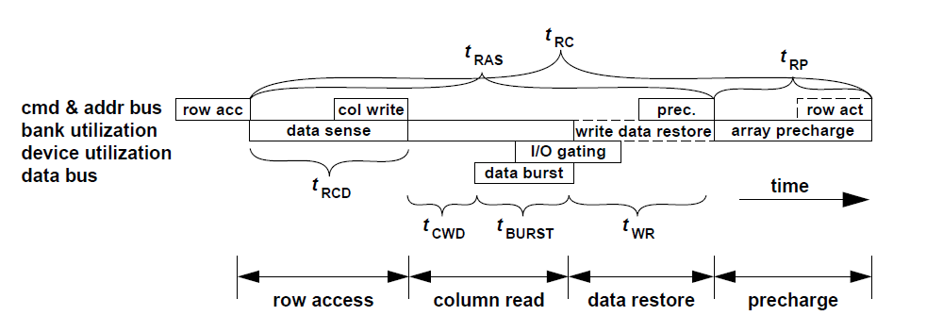

Slide 25
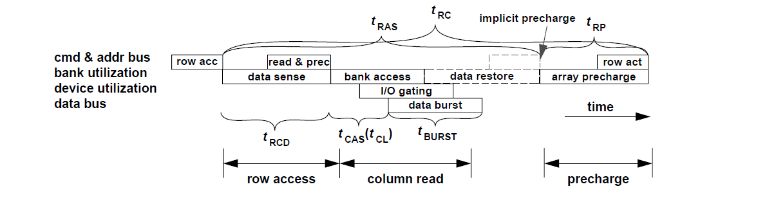
Compound Commands

Slide 26
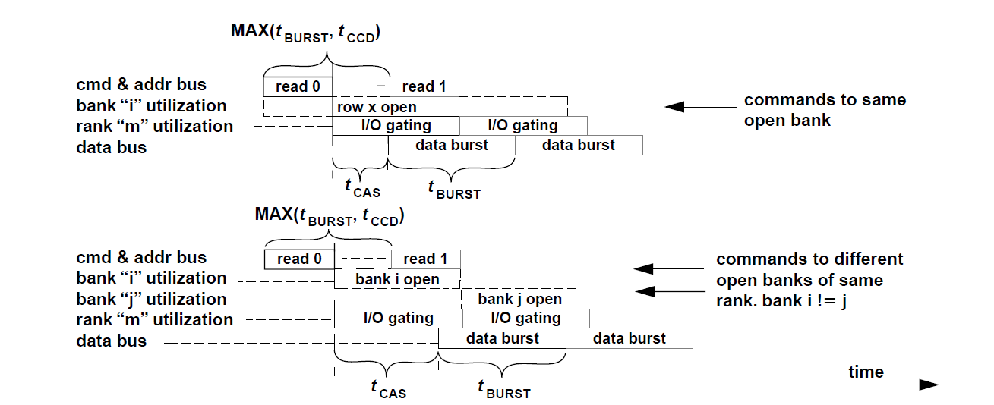
Consecutive Reads to Different Rows of Same Bank

Slide 27
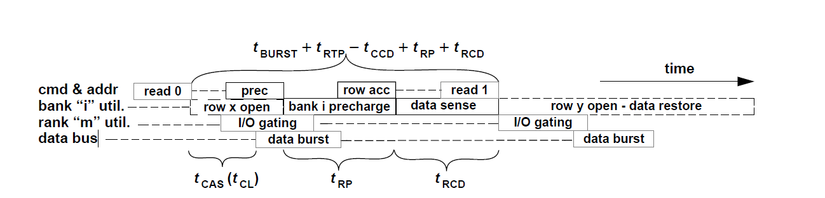

Slide 28
Consecutive Reads and Writes to Same Rank
In modern DRAM memory systems such as SDRAM, DDR SDRAM, and Direct RDRAM memory systems, read commands to the same open row of memory in the same bank, rank, and channel can be pipelined and scheduled consecutively subject to the burst durations of data on the data bus and the internal prefetch length of the DRAM device.

Slide 29
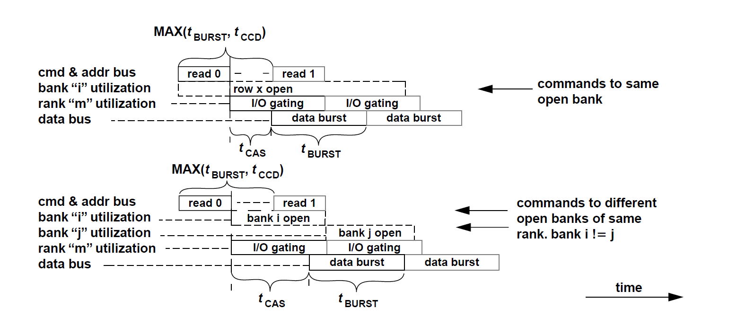

Slide 30
tCAS time after a column-read command is placed onto the command and address busses, the DRAM device begins to return data on the data bus.
Since column-read commands to any open banks of the same rank can
be pipelined consecutively, consecutive columnread commands to the same open row of the same bank of memory can be ideally scheduled every tBURST time period.
One caveat to the scheduling of consecutive column-read commands to an open row of a bank is that tBURST has to be greater than or equal to tCCD.

Slide 31
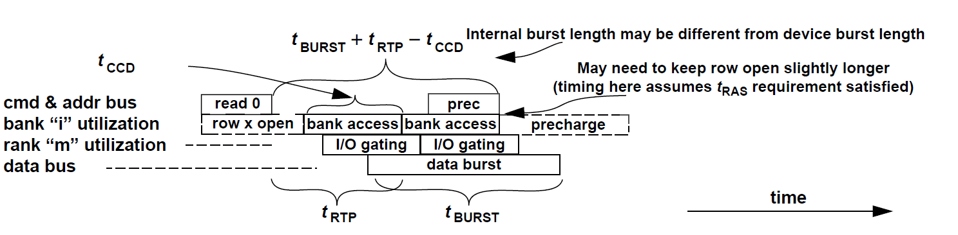
Read to Precharge Timing

Slide 32
the formula for minimum command timing as tBURST +tRTP -tCCD

Slide 33
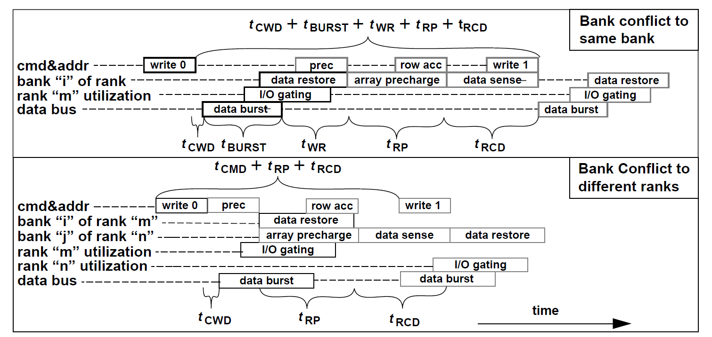
Consecutive Write Requests: Bank Confl icts

Slide 35
Phase 1:-
The command is transported through the address and command busses and decoded by the DRAM device
Phase 2:-
Data is moved within a bank, either from the cells to the sense amplifiers or from the sense amplifiers back into the DRAM arrays.
Phase 3:-
The data is moved through the shared I/O gating circuit and then through the read latches or write drivers, as appropriate
in each case.
Phase 4 :-
Read data is placed onto the data bus by the DRAM device in the case of a column- read command or by the memory controller in the case of a column-write command

Slide 36
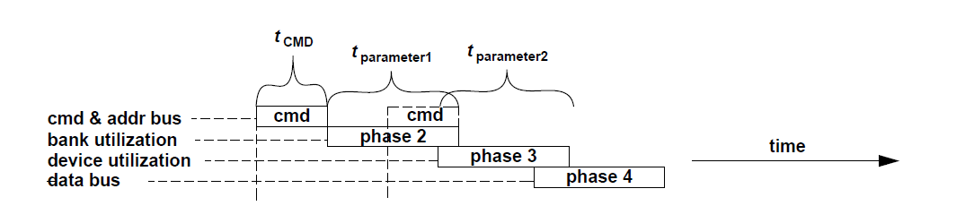
Generic DRAM Command Format
t CMD:-
The time period that it takes to transport the command from the DRAM
controller to the DRAM.
t parameter1:-
Defines the amount of time that the described command spends in the use
of the selected bank.
t parameter2:-
Defines the amount of time that the described command spends in the use of resources common to multiple banks of DRAM arrays in the same DRAM device also denotes the minimum amount of time that must pass between the scheduling of two commands whose relative timing is limited by the sharing of resources within a given bank of
DRAM arrays.

